Slide 1
THE UNABLE LARKS PREDICT TENNIS!!
A STUDY OF MACHINE-LEARNING AND TENNIS MATCH OUTCOMES…………

Slide 2
ORIGINS OF OUR STUDY & WHY WE CHOSE TENNIS
WANTED TO A RELATIONAL/OUTCOME-BASED STUDY
EACH MEMBER RESEARCHED DIFFERENT DATA SETS TO DETERMINE FEASIBILITY
FOUND TENNIS DATA TO BE REBUST
ALREADY KNOWLEDGE WITHIN THE GROUP OF THE SPORT
WANTED TO LEVERAGE EXISTING KNOWLEGDE WITHIN THE GROUP (E.G – SARA HAS PLAYED TENNIS FOR SOMETIME, INCLUDING COLLEGE!)

Slide 3

DATA SOURCES!
DATA SETS ARE FROM THE ASSOCIATION OF TENNIS PROFESSIONALS (ATP) WORLD TOUR
*** TENNIS DATA COMES FROM THE VARIOUS TOURNAMENTS OF THE ATP WITHIN 1 YEAR PERIODS. (include specifics??)

Slide 4
FUNDAMENTAL QUESTIONS
CAN WE PREDICT THE WINNER (OUTCOME) OF A TENNIS MATCH WITH MACHINE LEARNING ???
WITHIN THE AVAILABLE DATA, WHICH PLAYER STATISTICS SHOULD WE SELECT AS FEATURES (INPUTS) FOR OUR MODEL ???

Slide 5




DESCRIPTION OF SOURCE DATA & LOCATION
RAW DATA INCLUDES ALL PLAYER’S MATCHES AND RELEVANT GAME-STATISTICS (IN CSV FORMAT)
GROUP DECIDED MORE RECENT STATS MAY HAVE MOST RELEVANCE
CHOSE TO ANALYZE YEARS 2015 – 2018 (*** check accuracy)
CSV FILES USED CAN BE FOUND IN A “TENNIS ATP” GITHUB REPO: https://github.com/JeffSackmann/tennis_atp

Slide 6
DATA PREPARATION AND SORTING
FIRST STEP WAS TO SELECT THE YEARS WE EVENTUALLY WANTED TO TEST AND TRAIN ON:
AFTER SELECTING 2015 & 2016, WE PULLED EACH CSV INTO JUPYTER
THEN SORTED THE PLAYER NAMES, AND CREATED A UNIQUE LIST
NEXT WE SORTED THE PLAYERS BY WINNER AND LOSER

Slide 7
DATA PREPARTION AND SORTING
WE THEN SELECTED THE FEATURES (INPUTS) TO BE USED IN OUR MODEL, AND SUMMING. THEY INCLUDE………………………………………….
ACES
SERVICE GAMES
FIRST SERVE IN
FIRST SERVES WON
DOUBLE FAULTS
TOTAL BREAK PTS SAVED
TOTAL BREAK PTS FACED
BREAK POINT OPPONENT TOTAL
BREAK POINT OPPONENT LOSSES
SERVE POINT TOTAL

Slide 8
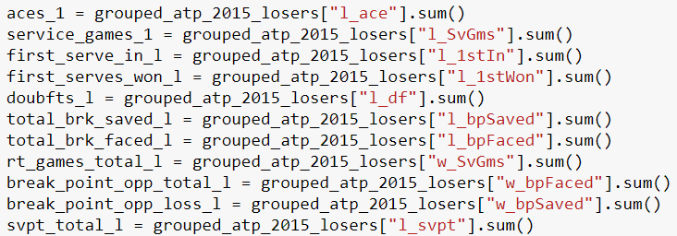
DATA PREPARATION AND SORTING
TOOK THE TOTALS FOR ALL THE FEATURES AND GROUPED THEM FOR BOTH THE WINNERS AND THE LOSERS

Slide 9
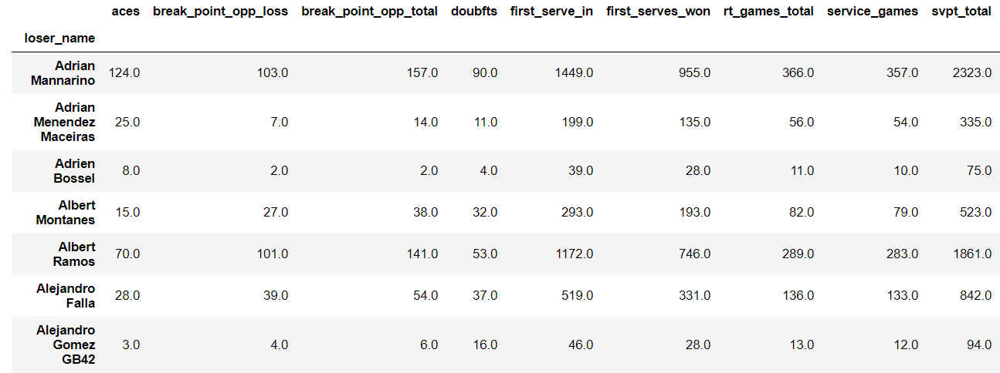
CREATE A DATAFRAME FOR ALL LOSER STATS

Slide 10
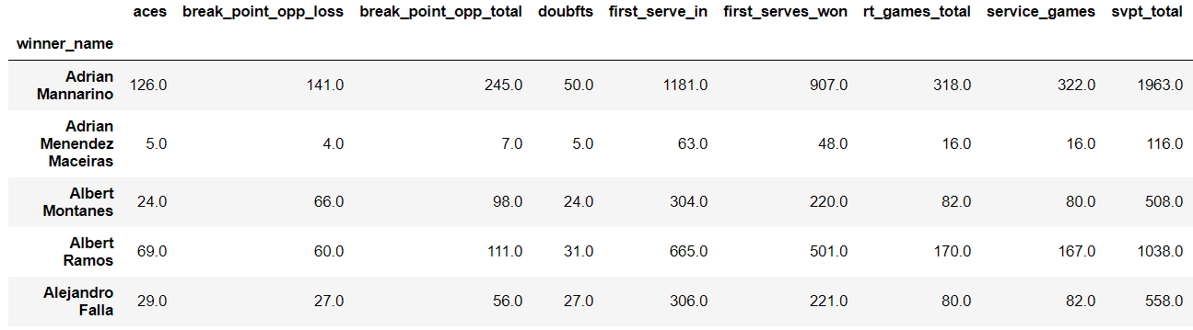
CREATE DATAFRAME FOR ALL WINNER STATS

Slide 11
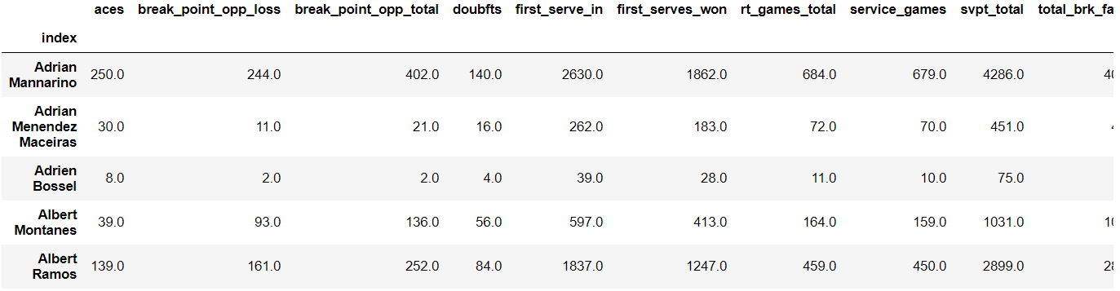
CREATE TOTAL DATAFRAME FOR ALL PLAYERS

Slide 12
STATISTICS WE CALCULATED FOR ADDITIONAL FEATURES
( **** LIST SOME OF THE STATS WE CALCULATED TO YIELD ADDITIONAL FEATURES FOR OUR MODEL***) excel screenshot, etc

Slide 13
CREATED PERCENTAGES FOR THE PLAYER’S STATS
total_player_stats["ace_pct"] = total_player_stats["aces"]/total_player_stats["svpt_total"]
total_player_stats["df_pct"] = total_player_stats["doubfts"]/total_player_stats["svpt_total"]
total_player_stats["first_serve_won_pct"] = total_player_stats["first_serves_won"]/total_player_stats["first_serve_in"]
total_player_stats["broken_pct"] = (total_player_stats["total_brk_faced"]-total_player_stats["total_brk_saved"])/total_player_stats["service_games"]
total_player_stats["breaking_pct"] = (total_player_stats["break_point_opp_total"]-total_player_stats["break_point_opp_loss"])/total_player_stats["rt_games_total"]
total_player_stats["break_conversion_pct"] = (total_player_stats["break_point_opp_total"]-total_player_stats["break_point_opp_loss"])/total_player_stats["break_point_opp_total"]

Slide 14
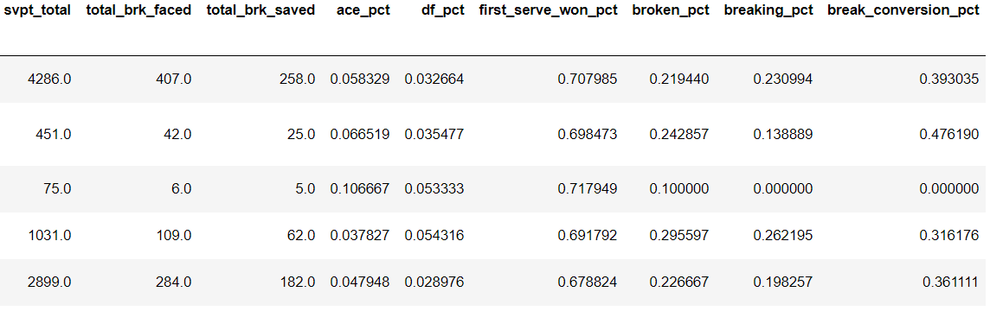
NEW DATAFRAME CREATED WITH ALL PLAYER STATS AND PERCENTAGES

